Slide 1

Java course
-4-

Slide 2
3.Webserver and Databases

Slide 3

What is a Database?
A database is a collection of information that is organized so that it can be easily accessed, managed and updated.

Slide 4
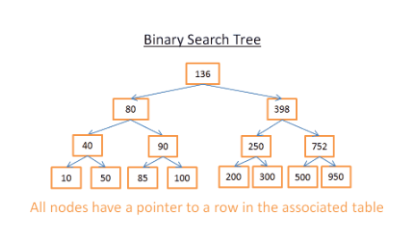
How a database works?

Slide 5
What is a query?
A query is a request for data or information from a database table or combination of tables. This data may be generated as results returned by Structured Query Language (SQL) or as pictorials, graphs or complex results

Slide 6
DB Engine types
Relational
Relational databases are also called Relational Database Management Systems (RDBMS) or SQL databases. Historically, the most popular of these have been Microsoft SQL Server, Oracle Database, MySQL, and IBM DB2. The RDBMS’s are used mostly in large enterprise scenarios, with the exception of MySQL, which is also used to store data for Web applications.
Non-Relational
Non-relational databases are also called NoSQL databases. NoSQL has become an industry standard term, but the name is beginning to lose popularity since it doesn’t fully cover the complexity and range of non-relational data stores that are available.

Slide 7
Relational DB Servers
Microsoft SQL Server
Microsoft SQL Server is a relational database management system developed by Microsoft..
Oracle Database
Oracle Database (commonly referred to as Oracle RDBMS or simply as Oracle) is a multi-model database management system produced and marketed by Oracle Corporation.
MySQL
MySQL is an open source relational database management system (RDBMS). Its name is a combination of "My", the name of co-founder Michael Widenius's daughter, and "SQL", the abbreviation for Structured Query Language.
IBM DB2
The names DB2and Db2 refer to database-server products developed by IBM. These products all support the relational model, but in recent years, some products have been extended to support object-relational features and non-relational structures like JSON and XML.

Slide 8
Connection to database
The interface for accessing relational databases from Java is Java Database Connectivity (JDBC). Via JDBC you create a connection to the database, issue database queries and update as well as receive the results.
JDBC provides an interface which allows you to perform SQL operations independently of the instance of the used database. To use JDBC, you require the database specific implementation of the JDBC driver.

Slide 9
Introduction to MySQL
To connect to MySQL from Java, you have to use the JDBC driver from MySQL. The MySQL JDBC driver is called MySQL Connector/J.
You find the latest MySQL JDBC driver under the following URL:
http://dev.mysql.com/downloads/connector/j.

Slide 10
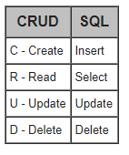
MySql CRUD operations
CRUD means Create, Read, Update, Delete, and it can mean different things in different systems, but for SQL Server, it is commonly considered to map to the following SQL operations on table records

Slide 11
Examples of CRUD
INSERT INTO `people` (`name`, `age`) VALUES ('John', 24) , ('Jane', 22);
SELECT `name`,`age` FROM `people` WHERE `age` > 22;
UPDATE `people` SET `age` = 23 WHERE `name` = 'Jane’;
DELETE FROM `people` WHERE `name` = 'Jane';

Slide 12
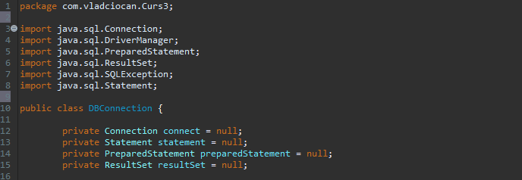
Create a connection in Java
Add dependencies and declare needed connection variabiles:

Slide 13
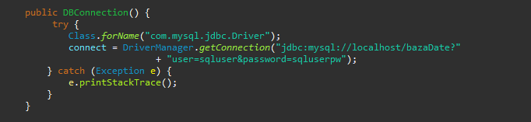
Create a connection in Java
Using the constructor create the connection using DriverManager

Slide 14
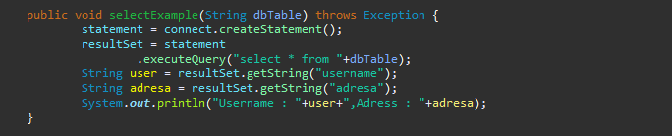
Create a connection in Java
Get values from DB

Slide 15
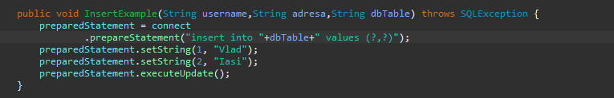
Create a connection in Java
Insert values into DB

Slide 16
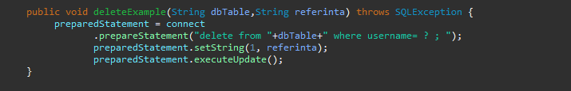
Create a connection in Java
Delete values from DB

Slide 17
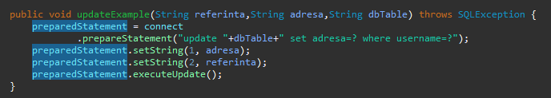
Create a connection in Java
Update values in DB

Slide 18
That`s it for today
Session review
-You learned DB Engines
-You learned about SQL server types
-You know how SQL works
-You learned how to connect to a DB
-you learned how to handle DB records
GOOD JOB! ☺

